Slide 1


Characterization of Coronal Mass Ejection Deflection using Coronagraph Image Sequences
Jenna L. Zink, GMU Undergraduate Research Scholars Program,
Rebekah M. Evans, NASA/GSFC, ORAU and GMU,
and
Karin Muglach, NASA/GSFC
Jenna – HSD is heliophysics science division at GSFC, it’s the logo for me and Karin

Slide 2
Introduction and Motivation
When analyzing CMEs in real time for space weather forecasting, a lack of sufficient coronagraph images can make it difficult to determine the CME’s position (latitude and longitude).
In these cases, usually the location of strong disk signatures (e. g., an associated flare, filament eruption, and coronal dimming) is used to estimate the CME’s propagation direction.
Although not an unreasonable assumption, many observational and modeling studies have shown that CMEs can deflect by ten or more degrees from the source location
E. g. MacQueen et al. 1986, Filippov, Gopalswamy & Lozhechkin 2001; Gopalswamy et al. 2009, 2010, Kilpua et al. 2009, Xie et al. 2009, Byrne et al. 2010, Lugaz et al. 2011, Zuccarello et al. 2012, Kay, Opher, & Evans 2013, Liu et al. 2014
Many of these previous works are single event studies

Slide 3
Sources of CME deflection
Magnetic forces (coronal holes, heliospheric current sheet)
Ambient solar wind interactions
CME-CME interactions
Usually it is assumed that deflection ends after low corona, but Liu et al. (2014) recently found deflection continued into the inner heliosphere
Space weather forecasting impacts
CME ensemble modeling by the Space Weather Research Center at NASA/GSFC shows that variation of the CME’s position by ten degrees can change the arrival time at 1 AU by several hours.
In this work we measure the deflection of many events, and will compare the deflection with the properties of nearby coronal holes

Slide 4
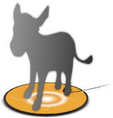
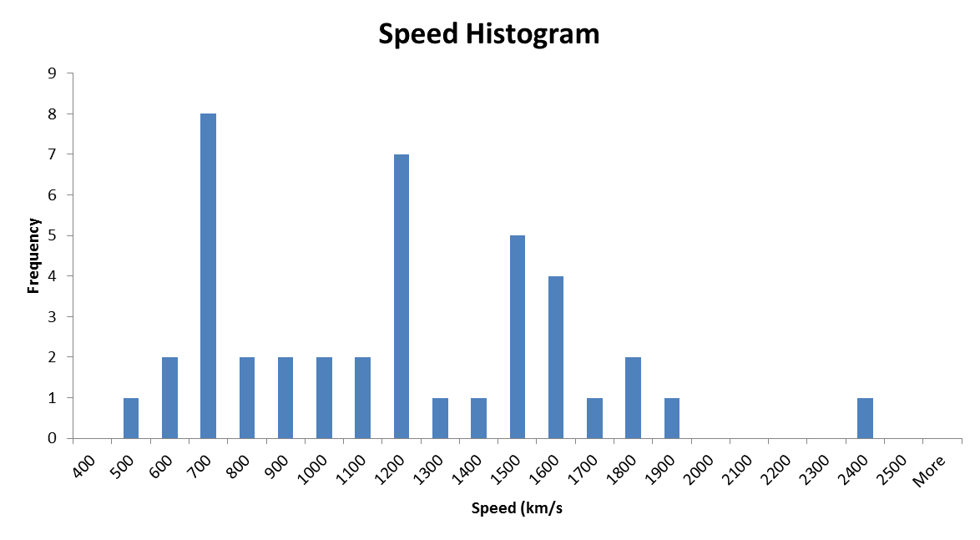
Event Selection Criteria
CCMC’s Database of Notifications, Knowledge and Information (DONKI) – searched during 2010-2014
Isolated event – not overlapping with another CME
Each event had to have a minimum of six images in two out of three SC (SOHO, STEREO A and B)
Pairs of images from different SC have ΔT<10 min
We want a range of CME widths and positions, so we did not restrict these parameters.
Initial DONKI queries:
CMEs with speeds greater than 1,000 km/s
CMEs with Interplanetary Shock arrivals at Earth, STA or STB
Later, expanded search to include C-type events and two events were included from Hess & Zhang, SPD 2014
Average CME speed in coronagraph FOV
(binned by 100 km/s)
S-type
C-type
O-type
R-type
Number of events

Slide 5
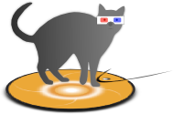
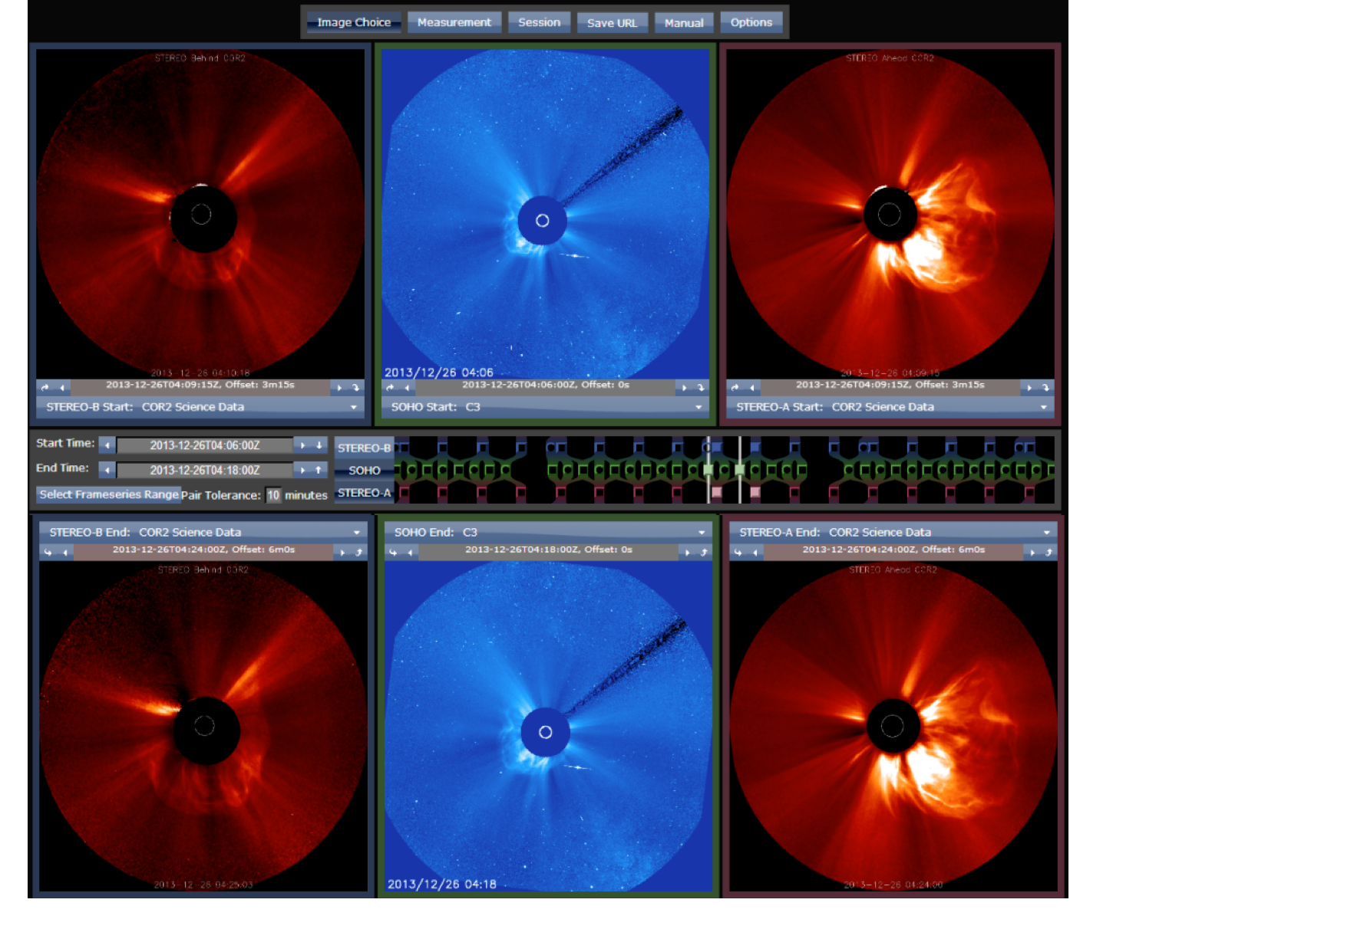
CCMC’s StereoCat Analysis Tool
A web-based and public CME Analysis tool used to measure CMEs as they propagate away from the Sun
Measures half-width, latitude, longitude, speed, and arrival time at 21.5 solar radii
Frameseries mode: width is allowed to vary with time
Used in space weather forecasting models
We assume that a change in the CME’s position is deflection
Not accounting for rotation or non-uniform expansion

Slide 6
Date | Time | Source Lon/Lat | Average Speed | Average Width | 1st Lon/Lat | Final Lon/Lat | Average Lon/Lat | Deflectionin Corona | Total Deflection
Year 2010
04/08 | 5:00 | -1, 24 | 694 | 21 | -4, -8 | 3, -6 | 0, -6 | 7.2 | 30.3
04/13 | 11:00 | - | 510 | 35 | 43, 40 | 43, 39 | 45, 39 | 1.0 | -
05/24 | 14:54 | 18, -15 | 669 | 36 | 10, -6 | 10, -1 | 10, -1 | 5.0 | 16.1
Year 2011
09/14 | 0:00 | 22, 23 | 489 | 31 | 9, 22 | 6, 23 | 5, 22 | 2.9 | 14.7
Year 2012
01/02 | 15:12 | 100, 10 | 1134 | 42 | 121, -9 | 109, -19 | 112, -18 | 15.3 | 30.3
01/19 | 15:10 | -27, 32 | 1099 | 51 | -37, 48 | -28, 46 | -35, 52 | 6.5 | 14.0
01/23 | 4:00 | 20, 28 | 1503 | 50 | 24, 22 | 0, 37 | 13, 27 | 25.6 | 19.1
01/26 | 5:30 | 78, 41 | 1138 | 43 | 67, 65 | 70, 72 | 69, 68 | 7.1 | 31.3
03/04 | 11:24 | -65, 16 | 1447 | 58 | -64, 28 | -50, 23 | -54, 24 | 13.6 | 15.8
06/13 | 14:00 | -21, -18 | 645 | 40 | 5, -33 | -16, -28 | -11, -32 | 18.7 | 11.0

Slide 7
Date | Time | Source Lon/Lat | Average Speed | Average Width | 1st Lon/Lat | Final Lon/Lat | Average Lon/Lat | Deflectionin Corona | Total Deflection
06/14 | 14:09 | -6, -19 | 1287 | 48 | -7, -23 | 2, -23 | -3, -24 | 8.3 | 8.5
07/12 | 16:54 | 2, -14 | 1458 | 39 | -2, -16 | -7, -18 | -5, -17 | 5.2 | 9.5
07/17 | 14:25 | 88, -15 | 1137 | 50 | 56, -35 | 55, -30 | 55, -34 | 5.1 | 33.8
07/23 | 2:36 | 136, -20 | 2326 | 54 | 131, 1 | 124, -4 | 128, -1 | 10.3 | 19.8
10/05 | 3:24 | - | 650 | 32 | 9, -22 | 8, -18 | 10, -19 | 4.1 | -
11/09 | 15:24 | -20, -20 | 691 | 33 | -5, -14 | -5, -11 | -7, -13 | 3.0 | 17.0
Year 2013
03/23 | 12:39 | -175, -25 | 1191 | 34 | 173, -30 | 170, -32 | 169, -32 | 3.3 | 14.9
04/21 | 16:39 | 125, 10 | 1151 | 31 | 113, 9 | 112, 14 | 111, 12 | 5.1 | 13.3
05/13 | 2:54 | -89, 10 | 1674 | 52 | -80, 6 | -73, 6 | -79, 7 | 7.0 | 16.3
05/17 | 9:24 | -36, 11 | 1474 | 44 | -44, 9 | -41, 14 | -44, 12 | 5.8 | 5.7
05/22 | 13:24 | 75, 13 | 1737 | 69 | 64, 5 | 62, 5 | 60, 6 | 2.0 | 15.1
06/13 | 4:09 | -172, -20 | 1432 | 29 | 174, -29 | 175, -28 | 175, -28 | 1.3 | 14.3

Slide 8
Date | Time | Source Lon/Lat | Average Speed | Average Width | 1st Lon/Lat | Final Lon/Lat | Average Lon/Lat | Deflectionin Corona | Total Deflection
07/22 | 6:24 | 162, 15 | 1091 | 69 | 144, 26 | 149, 27 | 147, 26 | 2.9 | 17.0
08/17 | 19:24 | 30, -4 | 1137 | 45 | 73, -15 | 74, -19 | 68, -16 | 4.1 | 45.5
11/07 | 10:39 | -153, 10 | 1863 | 67 | -109, -16 | -97, -5 | -102, -14 | 16.1 | 57.8
11/08 | 4:24 | Not Clear | 783 | 52 | 163, -37 | 154, -35 | 159, -35 | 7.5 | -
11/19 | 10:39 | - | 649 | 52 | 108, -33 | 105, -33 | 108, -33 | 2.5 | -
11/29 | 19:39 | 139, 10 | 701 | 76 | 135, -20 | 122, -13 | 127, -17 | 14.3 | 28.5
12/12 | 3:54 | 40, -25 | 1133 | 57 | 49, -33 | 62, -38 | 55, -36 | 11.7 | 22.7
12/26 | 3:40 | -171, -10 | 1314 | 66 | -132, -16 | -119, -24 | -127, -22 | 14.6 | 51.4
Year 2014
02/02 | 9:36 | 141, -20 | 861 | 63 | 118, -22 | 115, -18 | 117, -20 | 4.9 | 24.6
02/14 | 8:48 | - | 1500 | 53 | 134, -7 | 132, -8 | 123, -9 | 2.2 | -
02/22 | 12:24 | - | 1590 | 49 | 151, -40 | 173, -17 | 167, -24 | 29.9 | -
02/24 | 23:36 | - | 981 | 25 | 116, -32 | 117, -31 | 117, -30 | 1.3 | -

Slide 9
Date | Time | Source Lon/Lat | Average Speed | Average Width | 1st Lon/Lat | Final Lon/Lat | Average Lon/Lat | Deflectionin Corona | Total Deflection
02/25 | 1:25 | -77, -15 | 1766 | 81 | -81, -19 | -82, -19 | -82, -19 | 1.0 | 6.2
03/04 | 19:30 | - | 950 | 63 | 148, 82 | 149, 82 | 151, 79 | 1.0 | -
03/05 | 9:24 | - | 1513 | 67 | -159, -31 | -163, -21 | -163, -23 | 10.6 | -
03/12 | 14:39 | - | 1574 | 47 | -158, 30 | -157, 32 | -157, 32 | 2.2 | -
04/06 | 9:48 | 140, 10 | 653 | 42 | 131, 27 | 133, 32 | 132, 31 | 5.3 | 22.9
04/07 | 21:28 | - | 560 | 32 | 111, -35 | 95, -38 | 98, -38 | 13.2 | -
04/08 | 11:12 | 135, 10 | 611 | 38 | 138, 45 | 152, 41 | 149, 42 | 11.0 | 34.4
04/09 | 0:00 | -156, -10 | 843 | 79 | -112, 2 | -134, 15 | -131, 14 | 25.3 | 33.2
Summary of 42 events in data set
Range of speeds: 489 – 2,326 km/s
Average speed: 1,133 km/s
Range of widths: 21 – 81°
Average width: 48°
Source location determined by:
Flare location (if known)
EUV signatures in 195 and 304 Å (if possible)
If no clear signature could be found, box contains “-”

Slide 10
Preliminary Results I
Total Deflection and Average CME Speed
Due to availability of overlapping images between the different spacecraft, the height of the first and last measurements varies between events.
4 events with <10 degrees; 14 events with 20>x>10 degrees; 13 event >20 degrees
Lots of scatter – as to be expected

Slide 11
Preliminary Results II
Deflection (in corona) and Average CME Width
Due to availability of overlapping images between the different spacecraft, the height of the first and last measurements varies between events.
3D deflection exceeding >40 ° in 3 events

Slide 12
Preliminary Results III
Change in Latitude and Change in Longitude
Using the CME Source Location as Initial Value
Change in Latitude and Change in Longitude
Due to availability of overlapping images between the different spacecraft, the height of the first and last measurements varies between events.
Lots of scatter with changes in all 4 quadrants of the graph

Slide 13
Preliminary Results IV
Source Latitude and Change in Latitude
Due to availability of overlapping images between the different spacecraft, the height of the first and last measurements varies between events.
Scattering due to the difference between the source and final (measured) latitude

Slide 14
Preliminary Results V
Source Longitude and Change in Longitude
Due to availability of overlapping images between the different spacecraft, the height of the first and last measurements varies between events.
Lots of scatter due to selection of locations of CMEs
Scatter also due to difference between source and final (measured) longitude

Slide 15
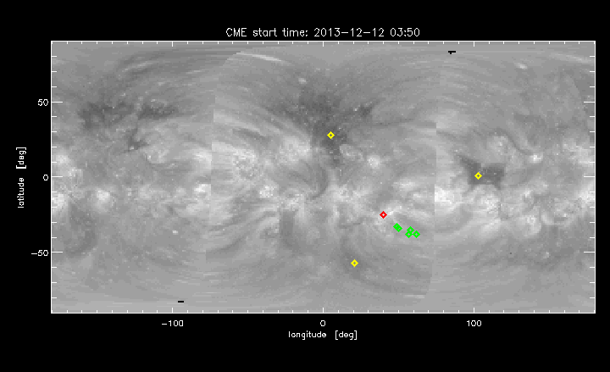
Preliminary Results VI
Tracking One Event from the Sun to 15 Rs
Mid and low latitude coronal holes within 90° in longitude of source locations were indentified by eye (not yet cross checked with magnetogram data or filament catalogs)
Source location
CME measurements
Coronal holes
Synoptic EUV map constructed from SDO, STA and STB EUVI
CME follows expected path due to presence of coronal holes
Total deflection is 22.7 ° , just in the corona 12°

Slide 16
Discussions, Conclusions, and Future Work
We analyzed 42 CMEs from 2010-2014 and found deflections range from less than 5 degrees to greater than 20 degrees from the source location to the edge of COR2 field of view
For one event, we identified nearby coronal holes. The measured path of the CME matches expected behavior
Limitations of our approach:
StereoCat is a simple tool that does consider the geometry of CME
Next step is to use other CME analysis tools (such as SWPC_CAT and GCS)
In progress:
Rigorous identification of coronal holes and the Coronal Hole Influence Parameter (Gopalswamy et al. 2009, 2010)
Use the results of this study to select appropriate ranges of latitudes and longitudes in CME ensemble modeling based on CME speed, width, location
How to incorporate coronal hole observations more systematically in real time CME analysis for space weather forecasting?
www.kauai.ccmc.gsfc.nasa.gov/SWRC_Tools.html
J. Zink would like to thank the NSF for travel support to attend this meeting through the CCMC Student Research Contest. J. Zink was supported by the GMU USRP. R. Evans was supported through an appointment to the NASA Postdoctoral Program at the Goddard Space Flight Center, administered by Oak Ridge Associated Universities through a contract with NASA.

